Slide 1

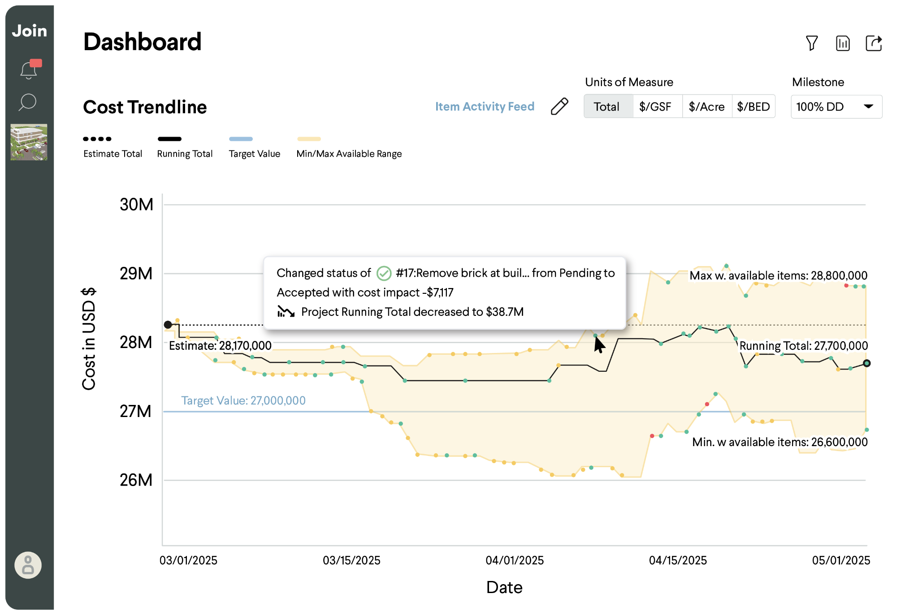
Pursuit toolkit
Join in your pursuit.
Build with confidence.
Your owner interview dedicates a few minutes to preconstruction. This guide shows how to use Join to tell a clear, confident preconstruction story — which modules to show, what each one says about your team, and a suggested flow based on your delivery method.
Reach out to us for support creating a demo environment for your next pitch.

Slide 2
Three to five minutes to earn the owner's trust.
When the conversation turns to preconstruction, the differentiator isn't which estimating tool you use — it's whether you can show the owner exactly how you'll manage cost, schedule, and design, every day of the project.
The problem
With Join
What the owner hears
Siloed spreadsheets and disconnected tools make it hard to present real-time cost and schedule impacts with confidence — exactly what an owner is probing for in an interview.
One shared platform connects budget, estimate, timeline, decisions, and risk. When something changes, the owner sees the impact reflected immediately — “the real estimate today, right now.”
“This team will keep me informed, involve me in decisions, and protect my budget and schedule from day one.” Confidence, transparency, and control.
The pages that follow are your snapshot library — pick the modules that match your pursuit, in the suggested order for your delivery method (slide 9).

Slide 3
Dashboard
Cost & schedule trending
The cost trendline shows your estimate, budget, target, and running total in real time — with every accepted or pending decision reflected the moment it changes.
In your pursuit
This is the single image that says “we are on top of your money.”
Point to a decision on the line and show the impact it had — confidence in numbers, live.
The min/max band shows the owner you manage the range, not just a number.
“Every decision your team makes shows up here the moment it's made — you'll always know the real number, not last month's number.”

Slide 4
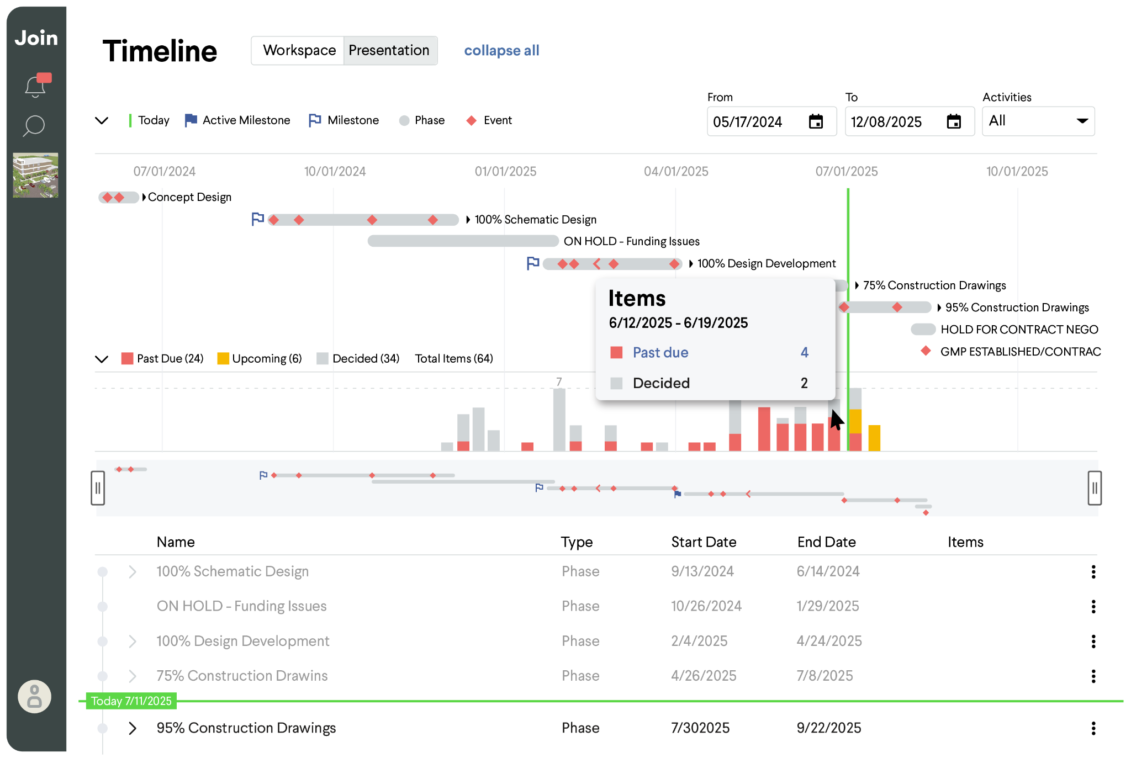
Timeline
Design & preconstruction timeline
One shared timeline connects design milestones, decision due dates, and procurement packages — so the full team can see why decision timing matters.
In your pursuit
Show buyout packages overlaid on design milestones — “here's how we'll manage overlap.”
Zoom to a package finalization to show decision deadlines feeding the dates.
Timeline is a strong opener for IPD and schedule-driven pursuits.
“A slipped decision in April impacts your budget in October — this is how we see it coming and act before it costs you.”

Slide 5
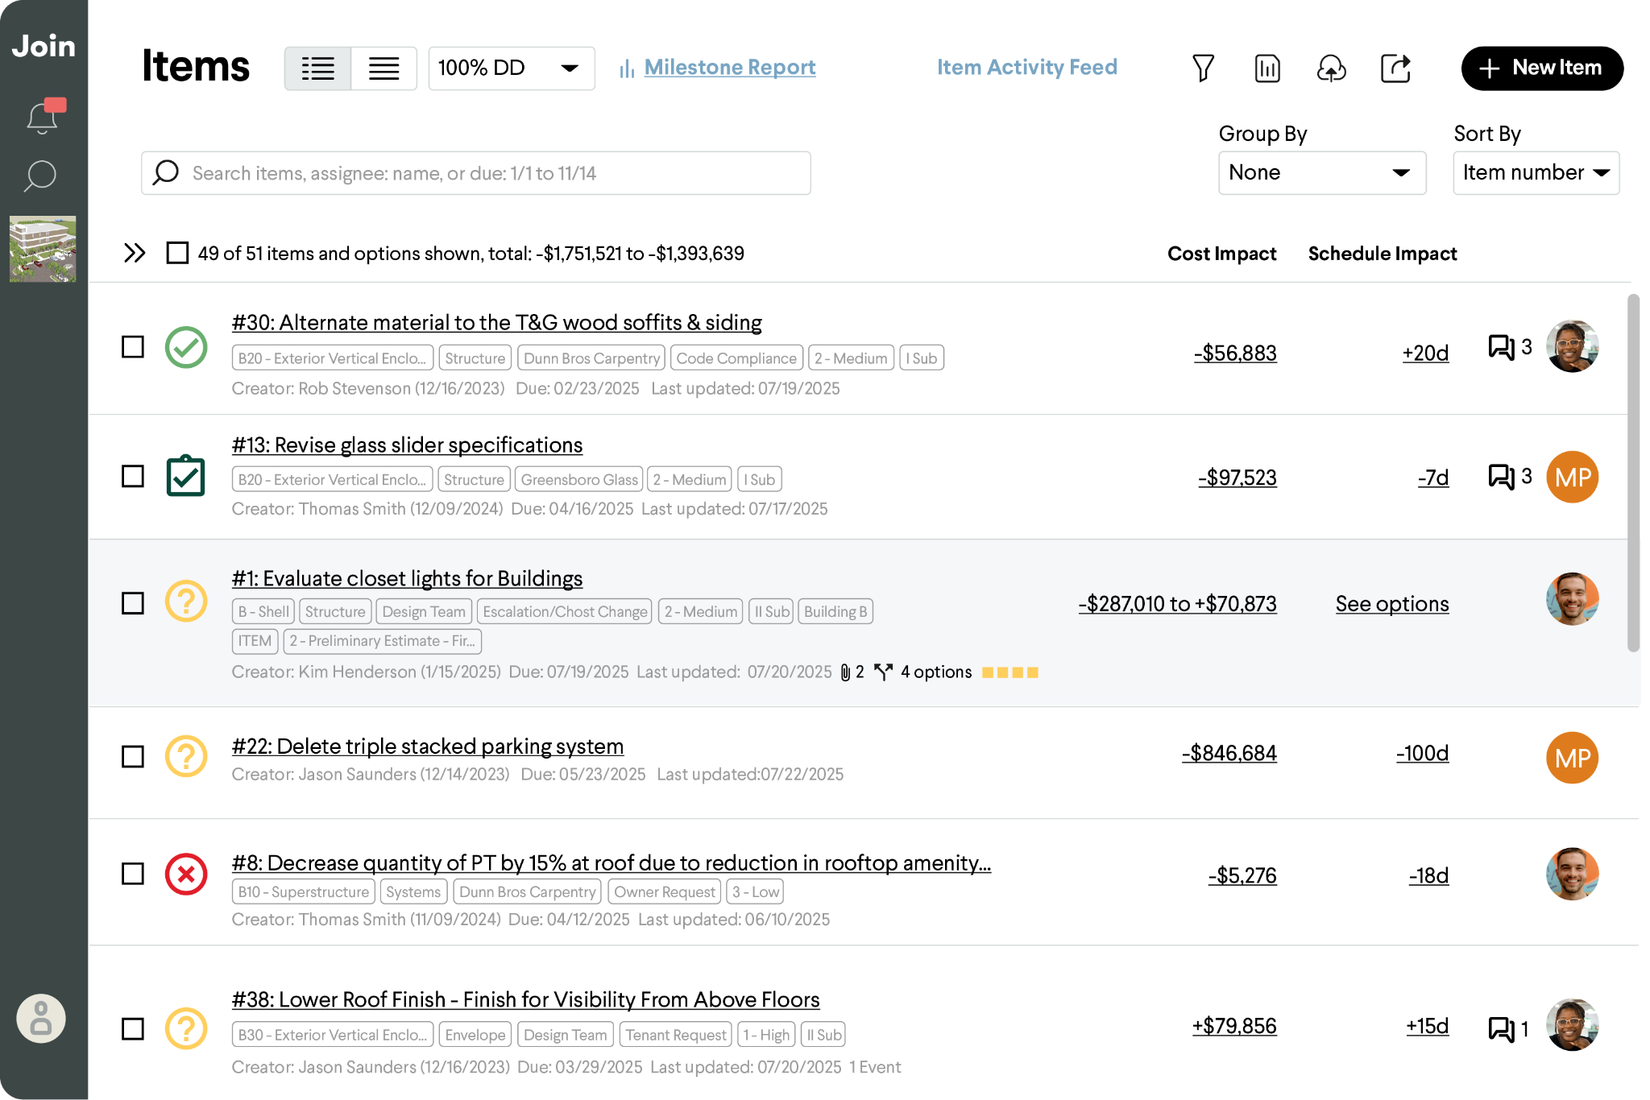
Items
Decision tracking
& the item list
Every open question becomes an item with cost impact, schedule impact, an owner, and a due date. Group by TVD cluster, UniFormat, assignee, or review status to match how your team runs the job.
In your pursuit
Group by TVD cluster for TVD pursuits; by UniFormat for CMAR/Design-Build — same data, tailored story.
Add a review-status grouping to show clear process and progression per package.
Cost and schedule impact side-by-side — nothing slips through the cracks.
“Every decision has a number, a date, and a name on it — and you'll see all three before we ask you to decide.”

Slide 6
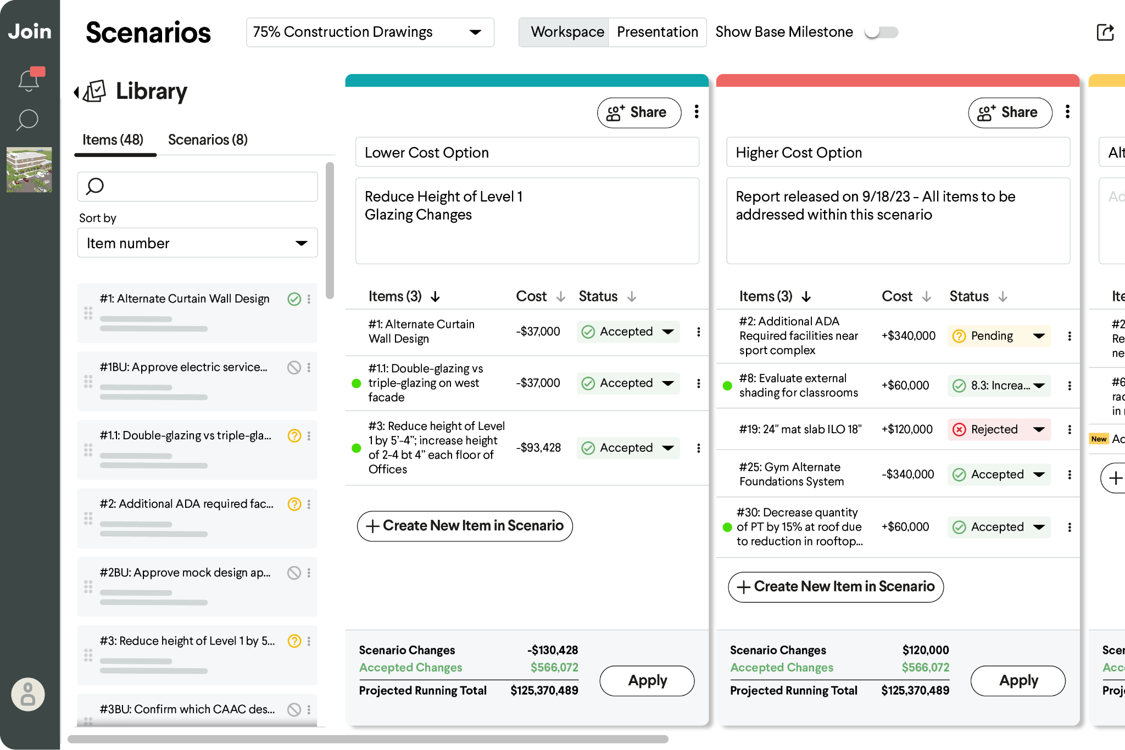
Scenarios
Scenario analysis
Explore what-if options side by side — comparing cost, design, and end-user value without rework or duplicate estimates.
In your pursuit
Best for pursuits where the owner faces real trade-offs (program, phasing, structure).
Show two or more options with live running totals — collaborative value management, not cut lists.
Tip: Switch from Workspace to Presentation mode for an clean & clear view
“When you're weighing options, we'll show you each path priced and side by side — you decide with the full picture.”

Slide 7
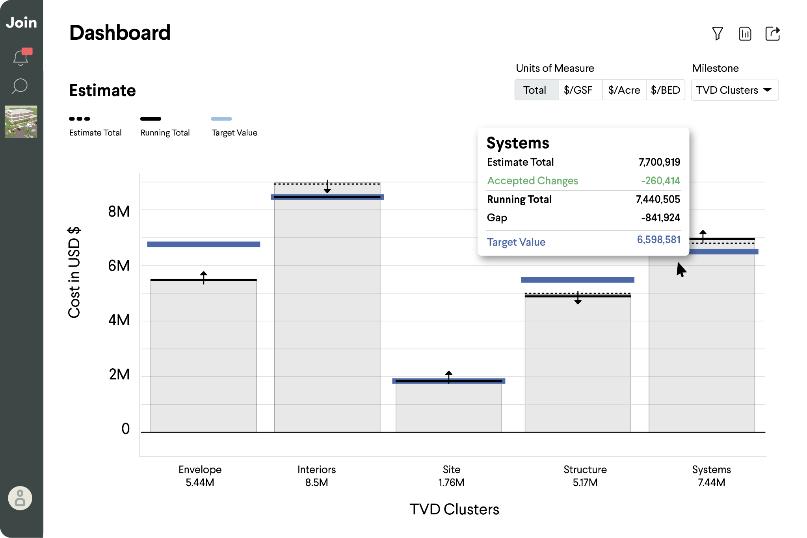
Estimate chart
Estimate by TVD cluster
Group the entire estimate by TVD clusters — Envelope, Interiors, Site, Structure, Systems — each tracked against its own target value.
In your pursuit
The signature TVD shot. Walk into a Big Room with the trendline, then click one filter to the cluster's report — no re-running reports.
Each cluster shows estimate vs. target — design-to-target, visibly.
Pairs with a cluster-grouped item list (Module 3) for pit-group sessions.
“Each cluster team designs to its own target, and everyone sees how their piece moves the whole — that's TVD, executable.”

Slide 8
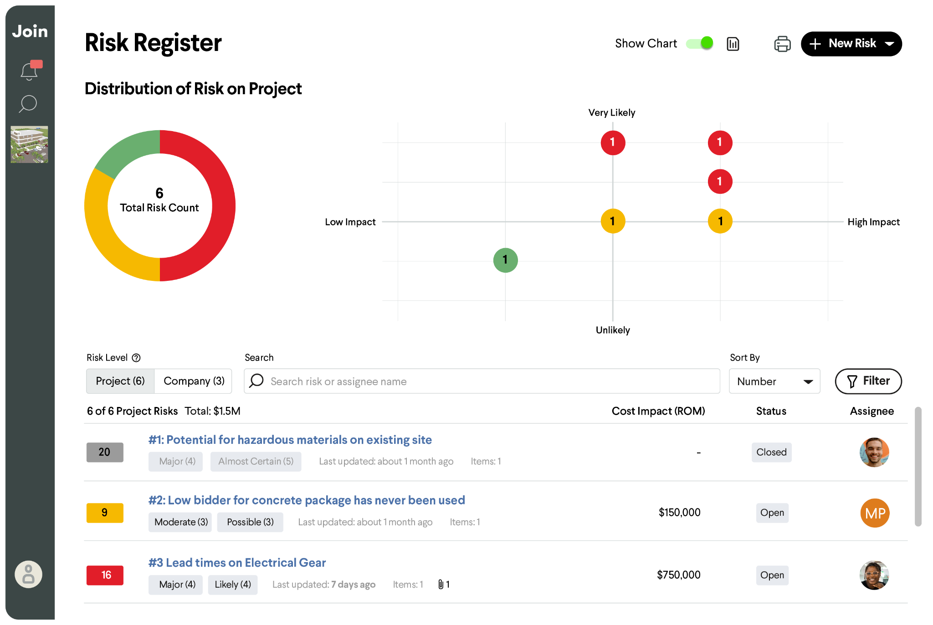
Reports & risk
Risk management
Identify, track, and mitigate risks in a shared workspace. Every risk gets an owner, an action plan, and a path from open to closed — supporting smarter contingency planning and fewer surprises.
In your pursuit
Open on the distribution chart — likelihood × impact at a glance shows a managed portfolio, not a list of worries.
Click into one risk: owner, mitigation plan, cost exposure, status. Specificity builds trust.
Tie it to contingency: “this is why our number is a plan, not a cushion.”
“Every risk on your project has a name next to it and a plan behind it — contingency you can see being managed, not just held.”

Slide 9
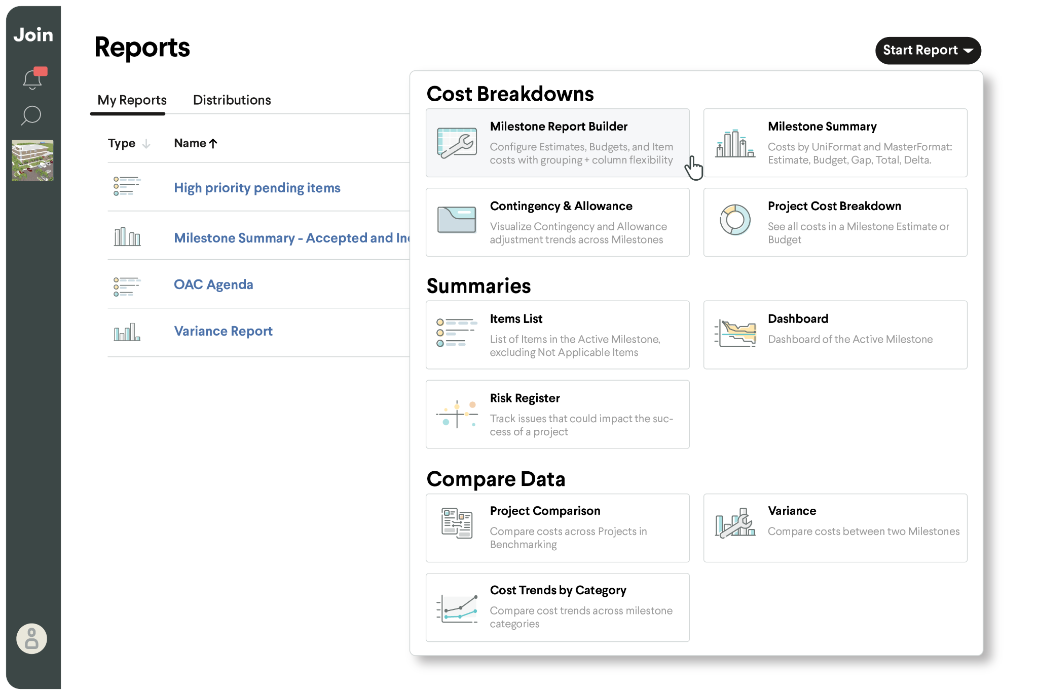
Reporting
Reporting
Saved reports with filters, groupings, and automated delivery cadences keep every stakeholder current between meetings. Variance reports measure progress against the previous milestone.
In your pursuit
One click from the Big Room view to a cluster or package report — no re-running anything live.
Show a variance report: “here's how we measure ourselves against the last milestone.”
Automated delivery means the owner is never waiting on a monthly PDF.
“The report you're seeing in this room is the same live view you'll have every day of the project — not a snapshot that's stale by Friday.”

Slide 10
Choose your flow
Suggested flow by delivery method / approach
Same platform, tailored story. Pick the path that matches your pursuit and walk the modules in order.
Target value design
IPD
Negotiated / CMAR / DB
Design-to-target, cluster-driven
Decision-velocity story
Transparency & control story
1. Estimate grouped by TVD cluster — each cluster vs. its target
2. Cost trendline — confidence in the running total
3. Items list grouped by cluster + review status
4. Filtered cluster report — one click, no re-running
5. Variance vs. last milestone — staying on target
1. Timeline — “here's where we are, and what's due”
2. Decisions upcoming — items list with due dates
3. Cost + schedule impact on every item
4. Scenarios for a live trade-off
5. Shared reports — everyone, same page, always
1. Cost trendline — real-time owner visibility
2. Items grouped by UniFormat — familiar structure
3. Scenarios — Value management with context, not cut lists
4. Contingency & allowance — managed, visible
5. Timeline with buyout packages overlaid
The cluster grouping is the moment owners lean in.
Lead with time; the team-alignment story wins IPD.
Emphasize the owner's window into everything.

Slide 11
10
Tips from teams who win with Join
1
Snapshots as a backup for live demos
2
Three to five minutes, three modules
Nothing beats a live Join experience. Alas, not all wifi is created equally. Plan ahead for a backup: use static snapshots or a short screen recording, saved locally.
Pick the modules that match your delivery method and owner priorities. A tight, confident story beats a feature tour every time.
3
Make it about their project
4
Open and close with confidence
Tailor groupings to what matters to this owner — their clusters, their packages, their milestones.
Start with the trendline (“we know the real number”), close with the shared-platform promise (“you'll always be in the room”).

Slide 12
11
We'll help you set it up.
Your Join team can spin up a pursuit-ready demo environment tailored to your sector — healthcare, education, civic, and more — usually within a day. Reach out to your customer success manager for supporto pick your focus areas, set your groupings, and rehearse your flow.
Not yet a customer? Reach out and we’ll get you up and running.
Book a pursuit session
join.build

