Slide 1
Join Sample Screenshots
For your RFP or Interview deck
© 2024 Join, Inc. All Rights Reserved.

Slide 2
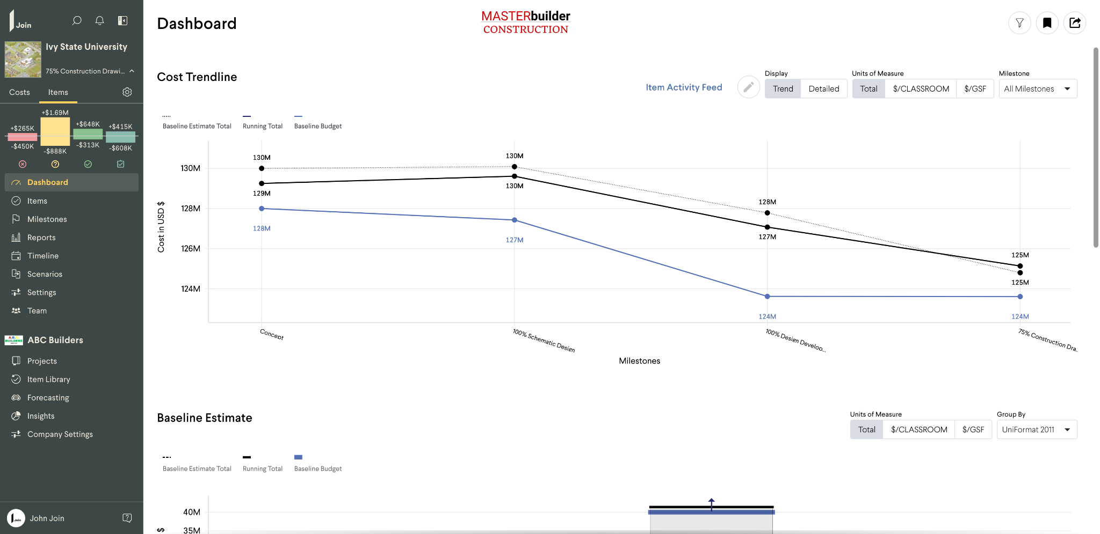
Dashboard (All Milestones View)

Slide 3
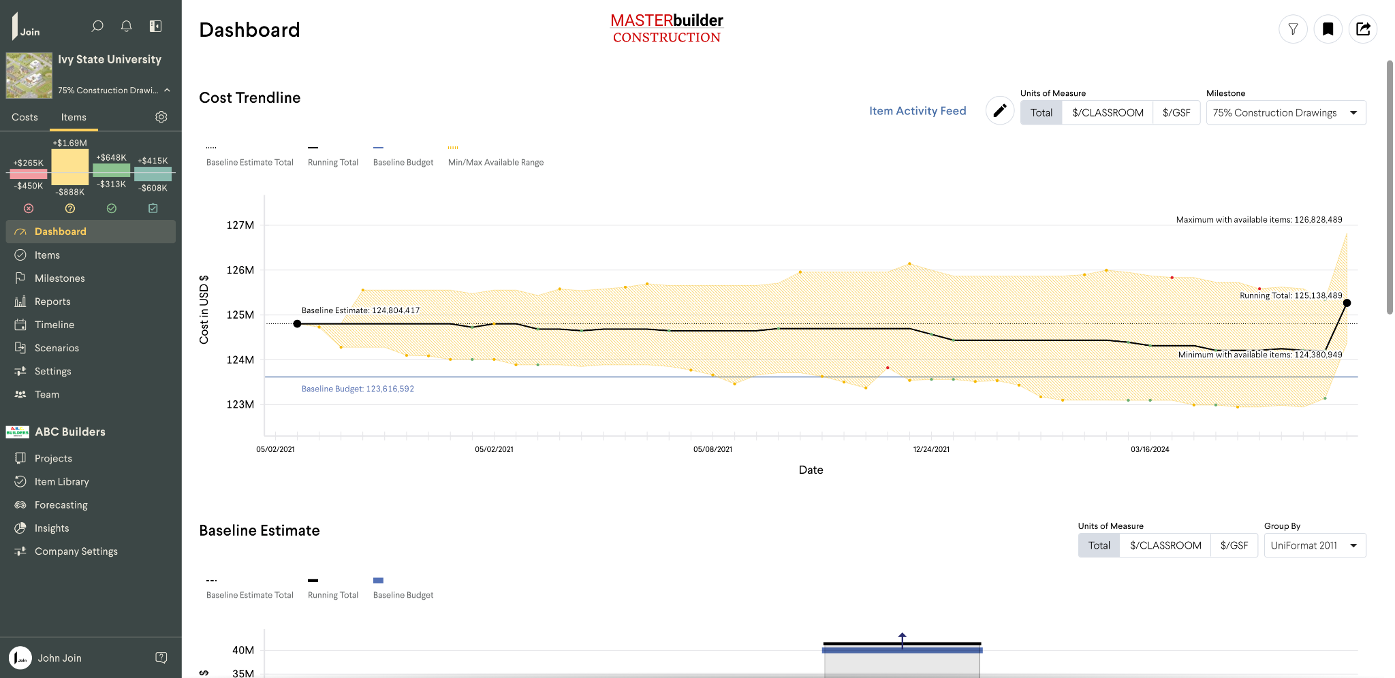
Dashboard (75% CD View)

Slide 4
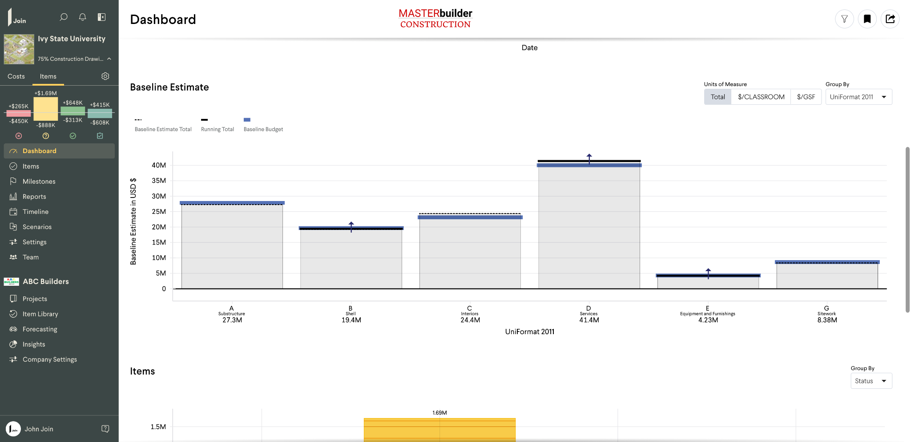
Dashboard (Baseline Estimate View)

Slide 5
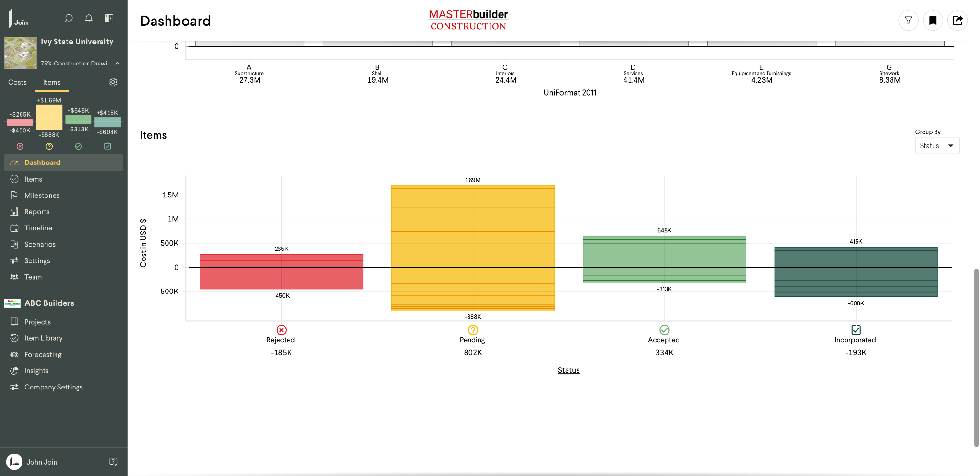
Dashboard (Items Chart)

Slide 6
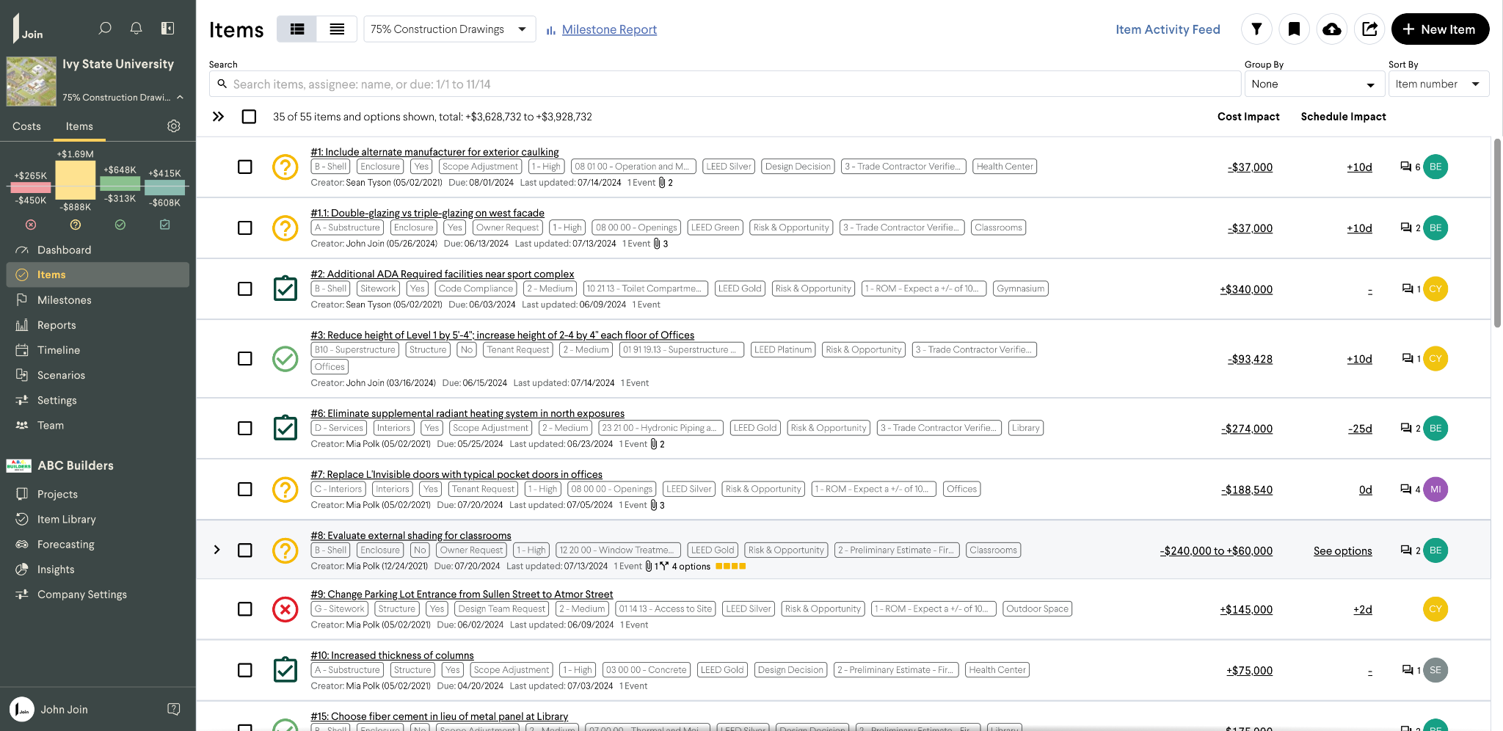
Items List

Slide 7
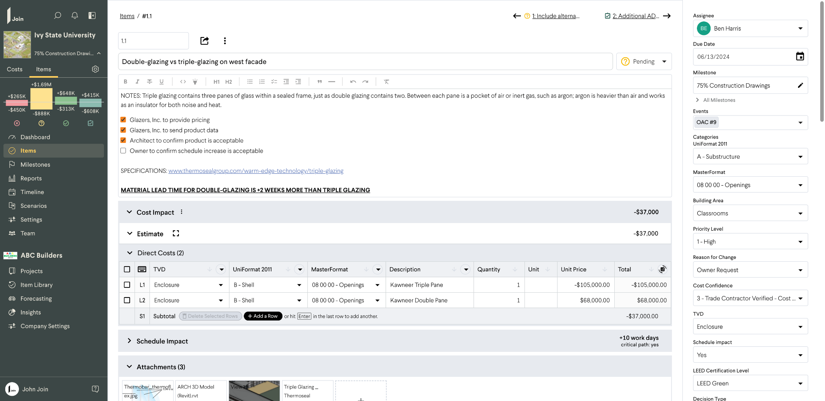
Item 1.1

Slide 8
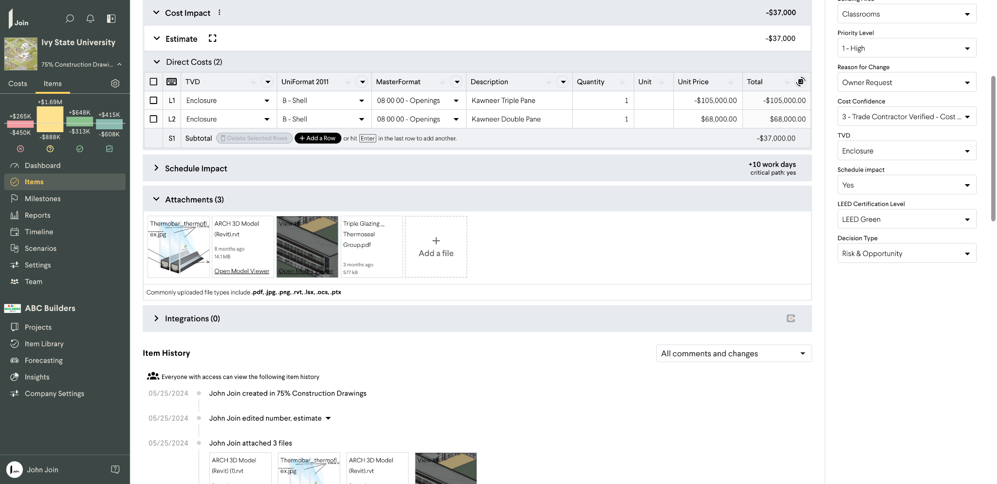
Item 1.1 (continued)

Slide 9
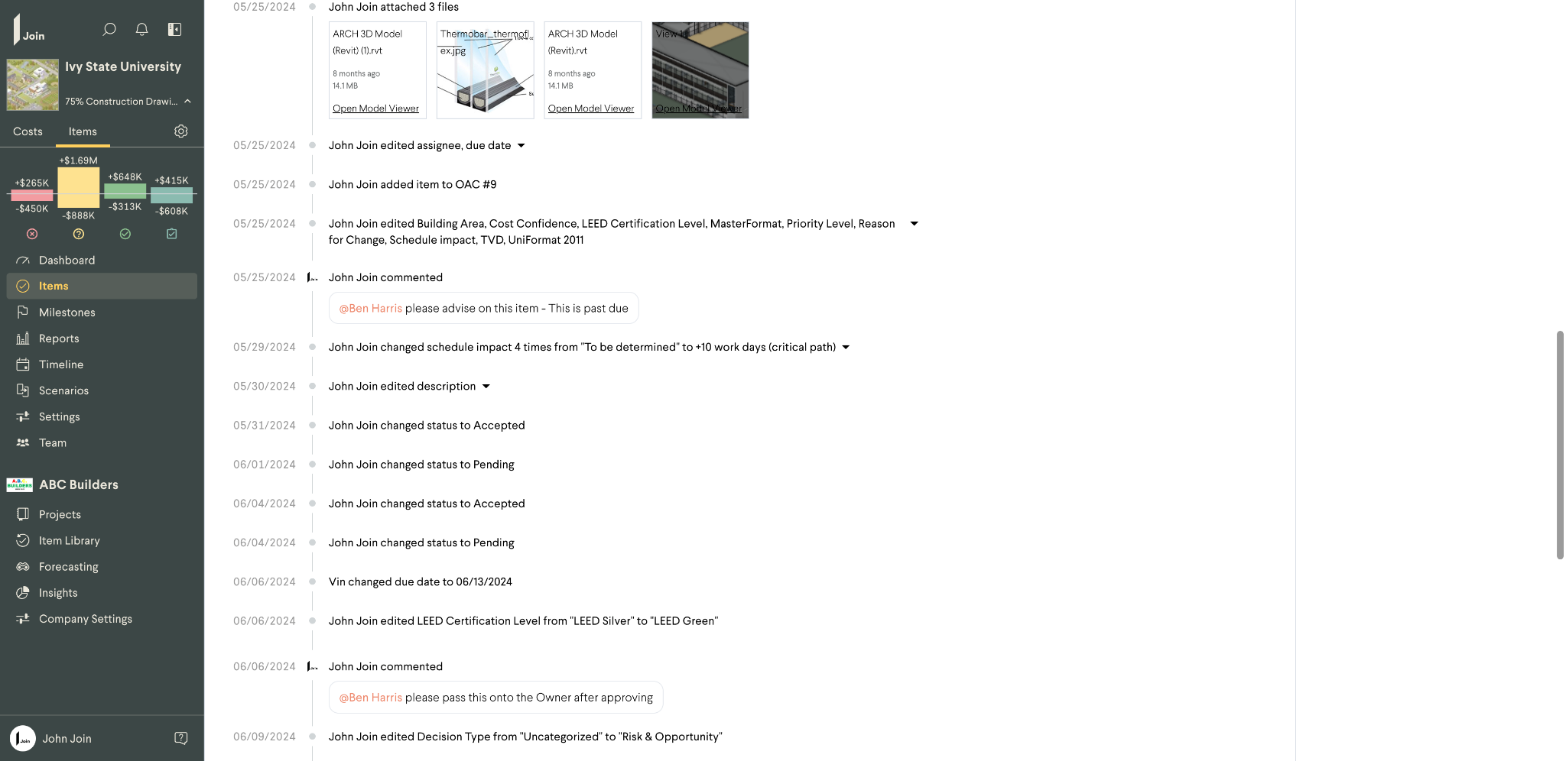
Item 1.1 (Item change history)

Slide 10
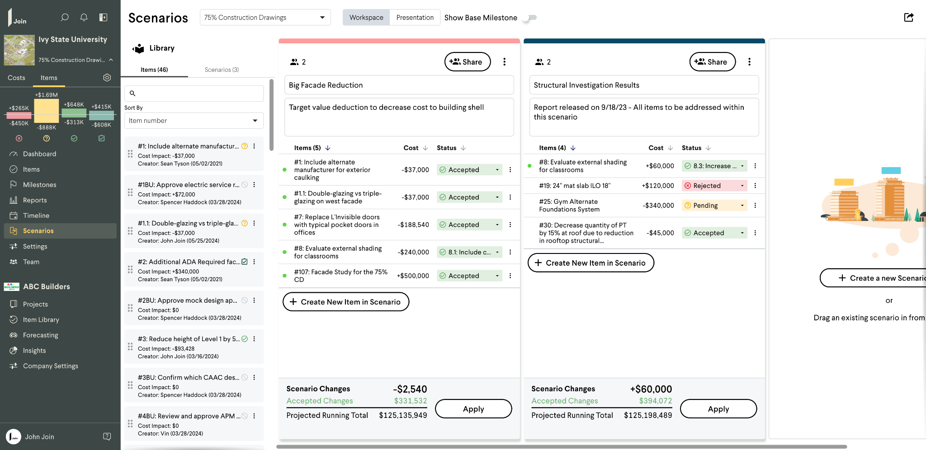
Scenarios Module

Slide 11
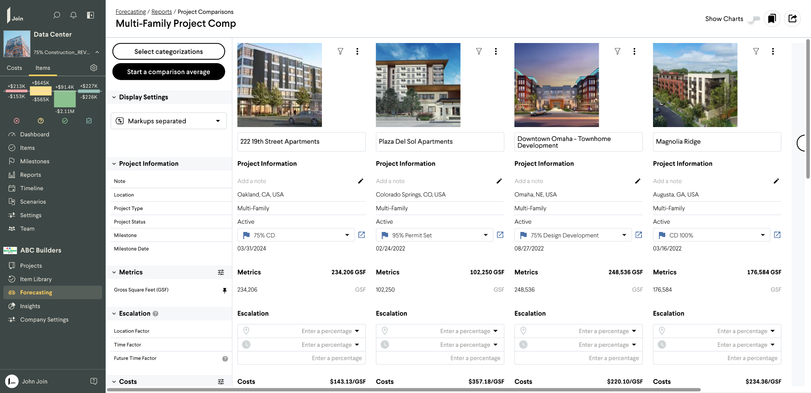
Forecasting (Historical Project Benchmarking)

